Slide 1
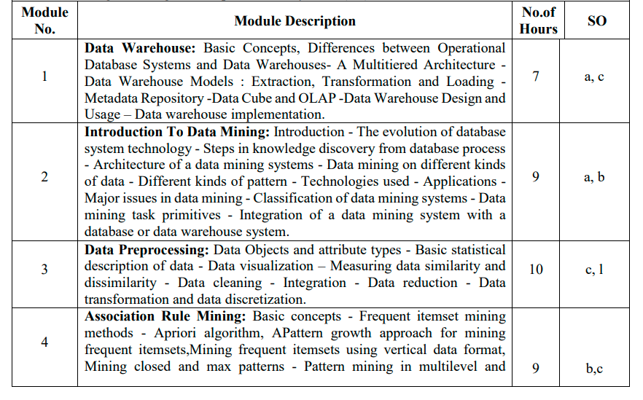
Module 3:Data preprocessing

Slide 2
Attribute and data objects
Data sets are made up of data objects. A data object represents an entity-
in a sales database, the objects may be customers, store items, and sales;
in a medical database, the objects may be patients;
in a university database, the objects may be students, professors, and courses.
Data objects are typically described by attributes and can also be referred to as:
samples
examples
instances
data points
objects
tuples
rows

Slide 3
Attributes:
Numeric
Continuous
Discrete
Categorical
Ordinal
Nominal
Binary
Symmetric
Non Symmetric
Interval scaled
Ratio-scaled

Slide 4
Central Tendency: Mean, Median, and Mode
Central tendency measure the location of the middle or center of a data distribution (where do most of its values fall?)
We require idea of the dispersion of the data by range, quartiles, and interquartile range; the five-number summary and boxplots; and the variance and standard deviation of the data.
Finally, we can use many graphic displays of basic statistical descriptions to visually inspect our data such as bar charts, pie charts, and line graphs.
Other popular displays of data summaries and distributions include quantile plots, quantile–quantile plots, histograms, and scatter plots

Slide 5
What Is a Quartile?
A quartile is a statistical term that describes a division of observations into four defined intervals based on the values of the data and how they compare to the entire set of observations.
KEY points
The quartile measures the spread of values above and below the mean by dividing the distribution into four groups.
A quartile divides data into three points—a lower quartile, median, and upper quartile—to form four groups of the dataset.
Quartiles are used to calculate the interquartile range, which is a measure of variability around the median.

Slide 6
How Quartiles Work
Just like the median divides the data into half so that 50% of the measurement lies below the median and 50% lies above it, the quartile breaks down the data into quarters so that 25% of the measurements are less than the lower quartile, 50% are less than the median, and 75% are less than the upper quartile.
A quartile divides data into three points—a lower quartile, median, and upper quartile—to form four groups of the dataset. The lower quartile, or first quartile, is denoted as Q1 and is the middle number that falls between the smallest value of the dataset and the median. The second quartile, Q2, is also the median. The upper or third quartile, denoted as Q3, is the central point that lies between the median and the highest number of the distribution.
Now, we can map out the four groups formed from the quartiles. The first group of values contains the smallest number up to Q1; the second group includes Q1 to the median; the third set is the median to Q3; the fourth category comprises Q3 to the highest data point of the entire set.

Slide 7
Each quartile contains 25% of the total observations. Generally, the data is arranged from smallest to largest:
First quartile: the lowest 25% of numbers
Second quartile: between 0% and 50% (up to the median)
Third quartile: 0% to 75%
Fourth quartile: the highest 25% of numbers

Slide 8
Example of Quartile
Suppose the distribution of math scores in a class of 19 students in ascending order is:
59, 60, 65, 65, 68, 69, 70, 72, 75, 75, 76, 77, 81, 82, 84, 87, 90, 95, 98
First, mark down the median, Q2, which in this case is the 10th value: 75.
Q1 is the central point between the smallest score and the median. In this case, Q1 falls between the first and fifth score: 68. (Note that the median can also be included when calculating Q1 or Q3 for an odd set of values. If we were to include the median on either side of the middle point, then Q1 will be the middle value between the first and 10th score, which is the average of the fifth and sixth score—(fifth + sixth)/2 = (68 + 69)/2 = 68.5).

Slide 9
Example of Quartile contd..
Q3 is the middle value between Q2 and the highest score: 84. (Or if you include the median, Q3 = (82 + 84)/2 = 83).
Now that we have our quartiles, let’s interpret their numbers. A score of 68 (Q1) represents the first quartile and is the 25th percentile. 68 is the median of the lower half of the score set in the available data—that is, the median of the scores from 59 to 75.
Q1 tells us that 25% of the scores are less than 68 and 75% of the class scores are greater. Q2 (the median) is the 50th percentile and shows that 50% of the scores are less than 75, and 50% of the scores are above 75. Finally, Q3, the 75th percentile, reveals that 25% of the scores are greater and 75% are less than 84.

Slide 10
Distributions:
Skewness is a way to describe the symmetry of a distribution.
Left skewed: A distribution is left skewed if it has a “tail” on the left side of the distribution:
Right skewed: A distribution is right skewed if it has a “tail” on the right side of the distribution:
Normal/ no skew: And a distribution has no skew if it’s symmetrical on both sides:

Slide 11
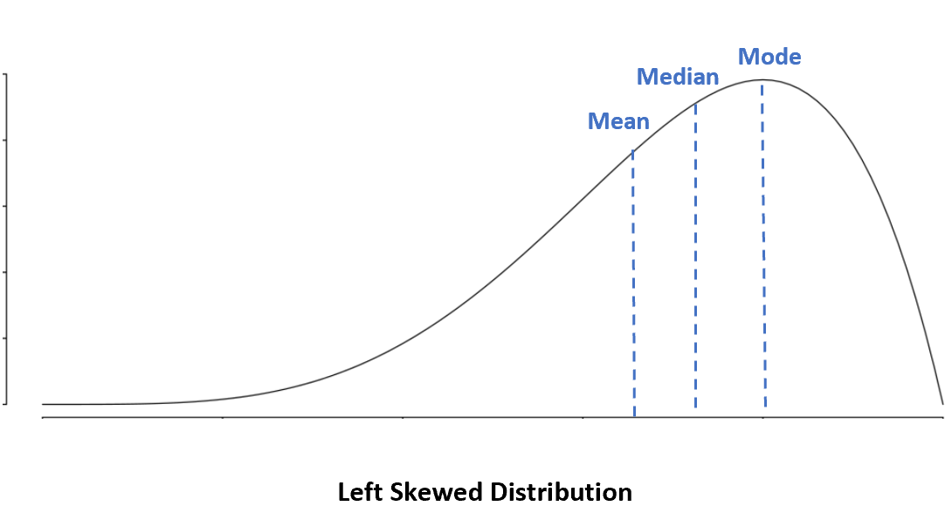
Left Skewed Distribution: Mean < Median < Mode

Slide 12
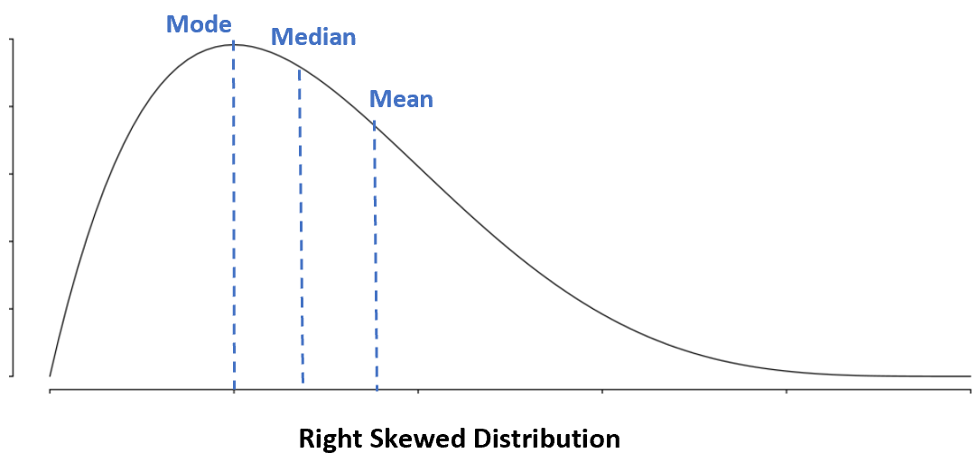
Right Skewed Distribution: Mode < Median < Mean

Slide 13
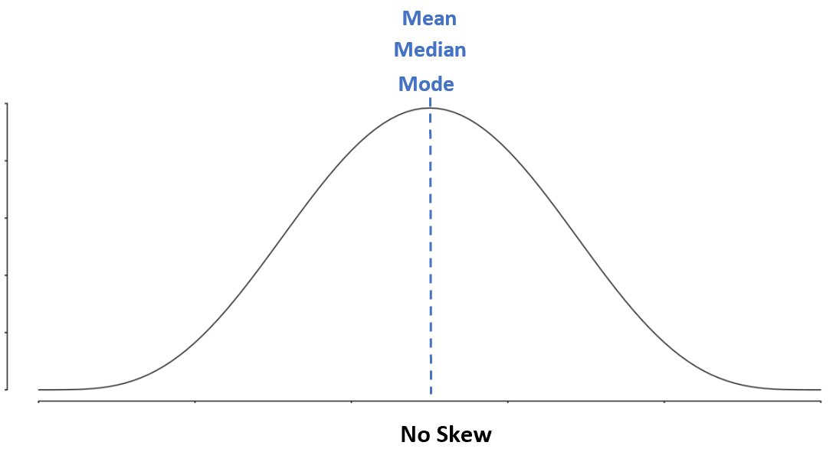
No Skew: Mean = Median = Mode

Slide 14
Using Box Plots to Visualize Skewness
A box plot is a type of plot that displays the five number summary of a dataset, which includes:
The minimum value
The first quartile (the 25th percentile)
The median value
The third quartile (the 75th percentile)
The maximum value

Slide 15
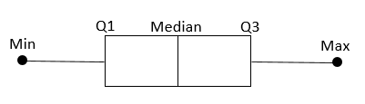
To make a box plot, we draw a box from the first to the third quartile. Then we draw a vertical line at the median. Lastly, we draw “whiskers” from the quartiles to the minimum and maximum value.

Slide 16
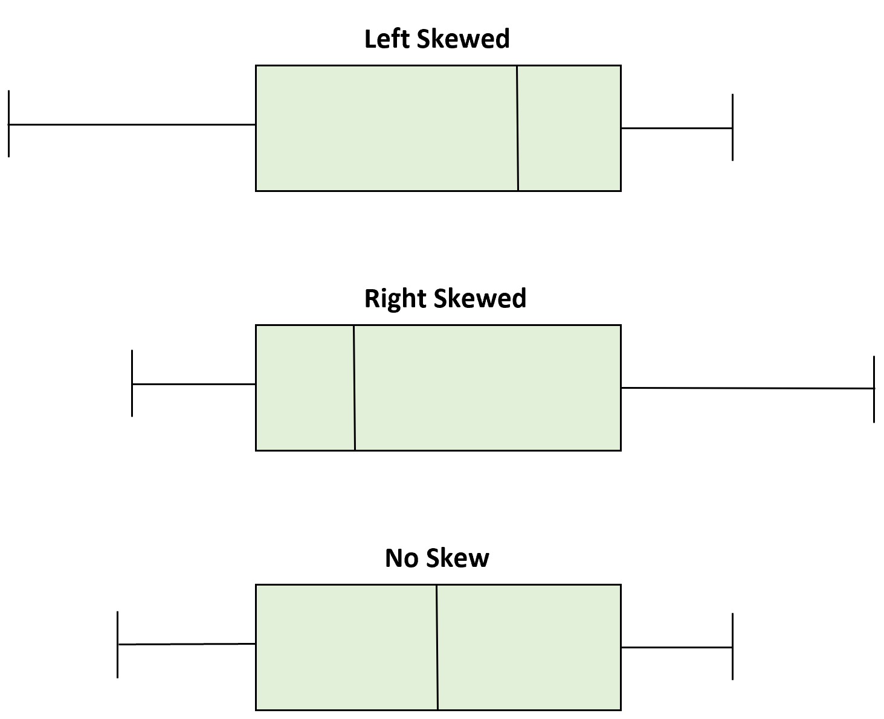
Depending on the location of the median value in the boxplot, we can tell whether or not a distribution is left skewed, right skewed, or symmetrical.

Slide 17
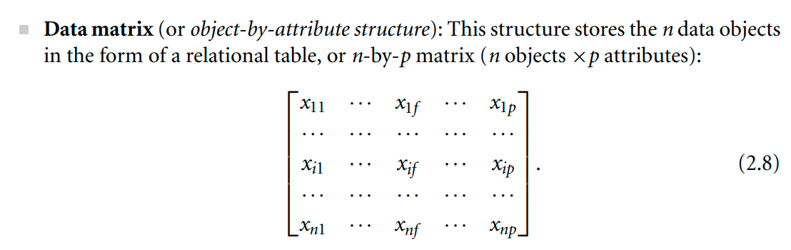
Data Matrix

Slide 18
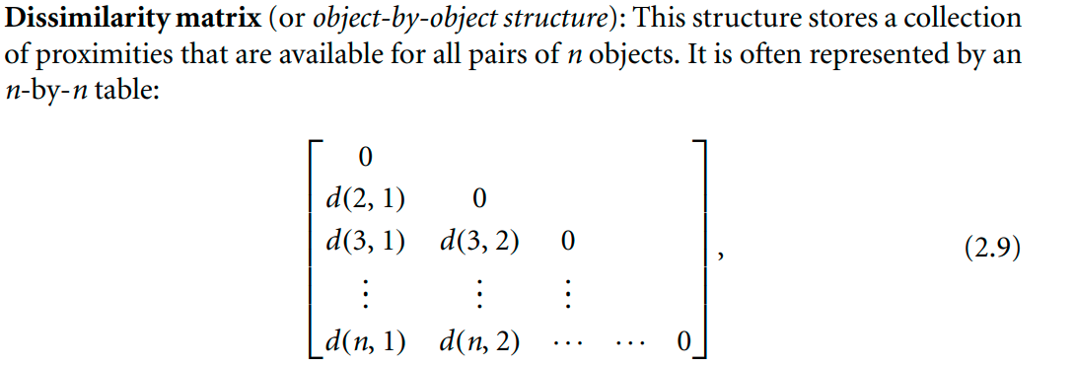
Dissimilarity Matrix
Note: We fill distance measures/proximity measures inside the dissimilarity matrix.

Slide 19
Dissimilarly Measures
Calculation of Dissimilarly measures for:
Numerical data
Ordinal data
Nominal data
Binary
Document data

Slide 20
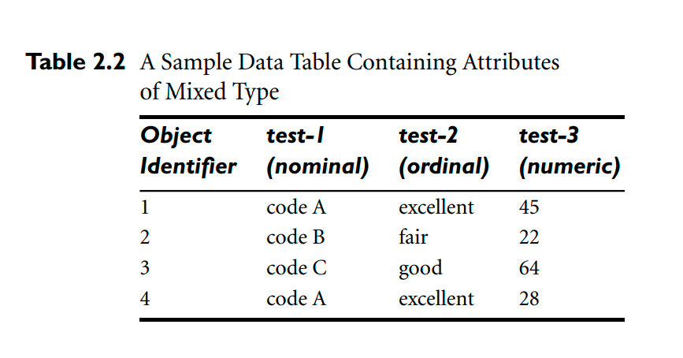
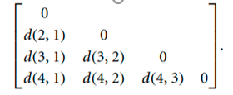
Dataset having various types of attributes

Slide 21
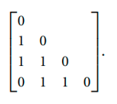
Dissimilarity of Nominal data:

Slide 22
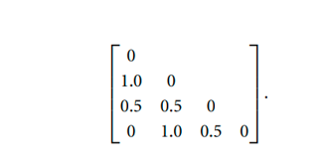
Dissimilarity matrix for Ordinal data

Slide 23
Dissimilarity of Numeric Data: Euclidean measure
The most popular distance measure is Euclidean distance (i.e., straight line or “as the crow flies”). Let i = (xi1, xi2,..., xip) and j = (xj1, xj2,..., xjp) be two objects described by p numeric attributes. The Euclidean distance between objects i and j is defined as

Slide 24
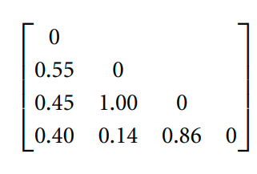
Dissimilarity matrix for Numeric attribute values

Slide 25
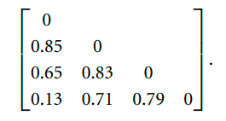
Dissimilarity for Attributes of Mixed Type
We can now use the dissimilarity matrices for the three attributes in our computation.
We get, for example, d(3, 1) = 1(1)+1(0.50)+1(0.45) 3 = 0.65.
The resulting dissimilarity matrix obtained for the data described by the three attributes of mixed types is:

Slide 26
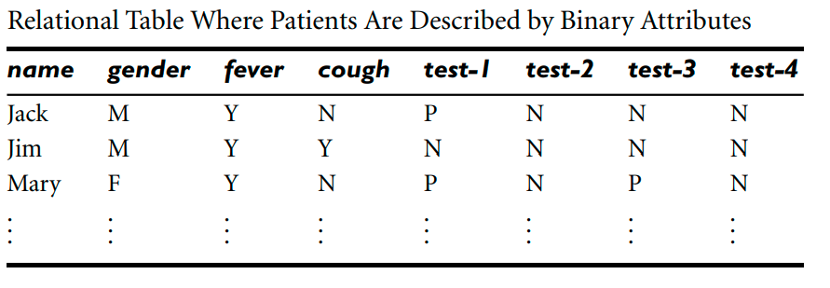
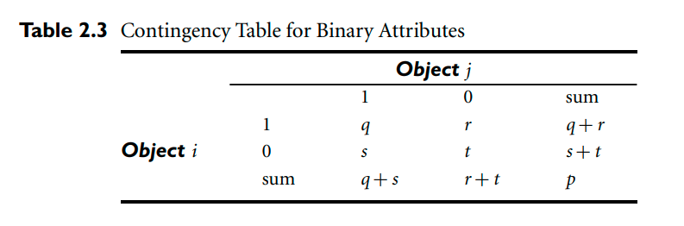

Proximity Measures/distance measure for Binary Data
In this example we will discuss about Asymmetric data only. So consider only
fever, cough, test 1, test 2, test 3, test 4 attributes only

Slide 27
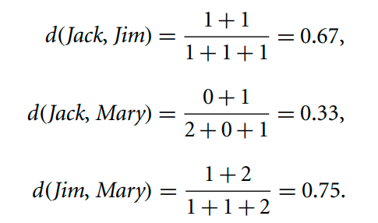
Proximity Measures/distance measure for Binary Data
Therefore the distance between jack and jim (d(1,2)) is .67.
Distance between jack and Mary (d(1,3)) is .33.
The distance between Jim and Mary (d(2,3)) is .75.

Slide 28
Dissimilarly Measures
Calculation of Dissimilarly measures for:
Numerical data
Ordinal data
Nominal data
Binary data
Document data

Slide 29
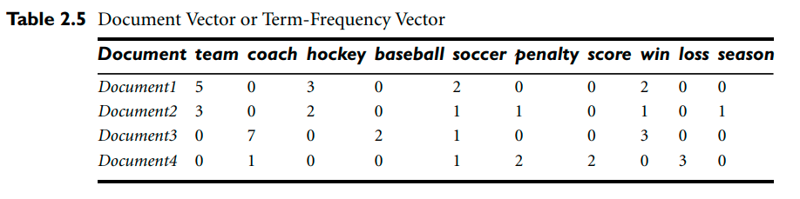
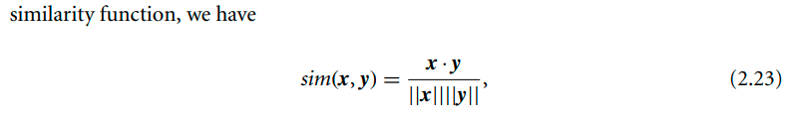
Distance measure for document data

Slide 30
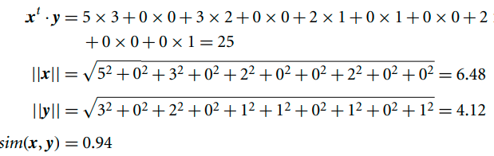
Example
Cosine similarity between two term-frequency vectors. Suppose that x and y are the first two term-frequency vectors (from previous table)
That is, x = (5,0,3,0,2,0,0,2,0,0) and y = (3,0,2,0,1,1,0,1,0,1). How similar are x and y? Using Eq. (2.23) to compute the cosine similarity between the two vectors, we get:

Slide 31
Preprocessing
Data Cleaning (potter wheel tool etc)
Missing values
Noisy data
process of data cleaning
Data integration
Data Reduction
Data Transformation

Slide 32
Data Cleaning
Missing Values
Ignore the tuple
Fill in the missing value manually
Use a global constant to fill in the missing value
Use a measure of central tendency for the attribute (e.g., the mean or median) to fill in the missing value
. Use the most probable value to fill in the missing value

Slide 33
Data Cleaning
Noisy data
Binning:
Partition into (equal-frequency) bins:
Smoothing by bin means:
Smoothing by bin boundaries
Regression
Outlier Analysis

Slide 34
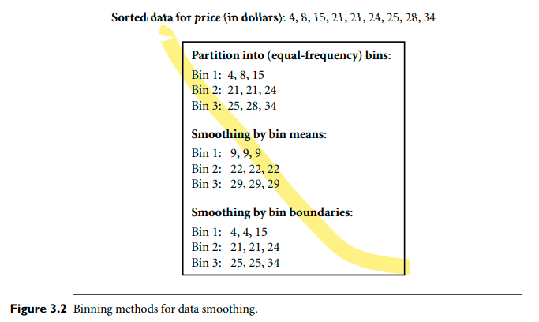
Smoothing by bin means and Smoothing by bin boundaries
Noisy data

Slide 35
Noisy data
Regression:
Data smoothing can also be done by regression, a technique that conforms data values to a function. Linear regression involves finding the “best” line to fit two attributes (or variables) so that one attribute can be used to predict the other. Multiple linear regression is an extension of linear regression, where more than two attributes are involved and the data are fit to a multidimensional surface.

Slide 36
Noisy data
Outlier analysis:
Outliers may be detected by clustering, for example, where similar values are organized into groups, or “clusters.” Intuitively, values that fall outside of the set of clusters may be considered outliers

Slide 37
Thank You

